Slide 1
SQLAdria 2025 Vodice, Croatia June 5th, 2025
Experience AI queries
through SQL Data Insights Hands-on Lab
Guillaume Arnould
Diego Cardalliaguet

Slide 2
Notices and disclaimers
© 2021 International Business Machines Corporation. No part of this document may be reproduced or transmitted in any form without written permission from IBM.
U.S. Government Users Restricted Rights — use, duplication or disclosure restricted by GSA ADP Schedule Contract with IBM.
Information in these presentations (including information relating to products that have not yet been announced by IBM) has been reviewed for accuracy as of the date of initial publication and could include unintentional technical or typographical errors. IBM shall have no responsibility to update this information. This document is distributed “as is” without any warranty, either express or implied. In no event, shall IBM be liable for any damage arising from the use of this information, including but not limited to, loss of data, business interruption, loss of profit or loss of opportunity. IBM products and services are warranted per the terms and conditions of the agreements under which they are provided.
IBM products are manufactured from new parts or new and used parts. In some cases, a product may not be new and may have been previously installed. Regardless, our warranty terms apply.”
Any statements regarding IBM's future direction, intent or product plans are subject to change or withdrawal without notice.
Performance data contained herein was generally obtained in a controlled, isolated environments. Customer examples are presented as illustrations of how those
customers have used IBM products and the results they may have achieved. Actual performance, cost, savings or other results in other operating environments may vary.
References in this document to IBM products, programs, or services does not imply that IBM intends to make such products, programs or services available in all countries in which IBM operates or does business.
Workshops, sessions and associated materials may have been prepared by independent session speakers, and do not necessarily reflect the views of IBM. All materials and discussions are provided for informational purposes only, and are neither intended to, nor shall constitute legal or other guidance or advice to any individual participant or their specific situation.
It is the customer’s responsibility to insure its own compliance with legal requirements and to obtain advice of competent legal counsel as to the identification and interpretation of any relevant laws and regulatory requirements that may affect the customer’s business and any actions the customer may need to take to comply with such laws. IBM does not provide legal advice or represent or warrant that its services or products will ensure that the customer follows any law.
IBM Systems Technical University © Copyright IBM Corporation 2020
2

Slide 3
Agenda
Opening
SQL DI HOL - Introduction
(15 minutes)
SQL DI HOL - Data preparation, Semantic queries on Db2 v13 (45 minutes)

Slide 4
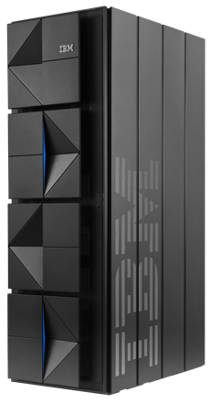



Hands-On-Lab Architecture
VPN Network
SQL Data Insight
z/OS
IBM z16
Web Browser
IBM Client Engineering EMEA environment
Student Workstation (Windows, Mac, Linux)

Slide 5
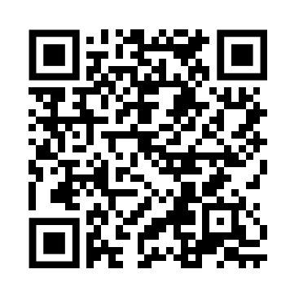
Hands-on Lab1 materials
Please download the hands-on lab scripts from this github repository.
https://github.com/PasamonteG/SQLDI_Install/tree/main/SQLAdriaLab or
Please find the zVA Jumpbox VMs and credential for the hands-on lab 1 in the table below
Student | zVA Web Access Point | zVA User for Web Access Point | zVA Password
Student1 | https://T-6554-159-8-176-78.ibmztrialmachines.com/ | Administrator | TwyjK9N6BT2vyC0eJAtz
Student2 | https://T-6555-159-8-134-214.ibmztrialmachines.com/ | Administrator | AIz2VqHLNS5S0wVzws4l
Student3 | https://T-6556-159-8-176-68.ibmztrialmachines.com/ | Administrator | QJ3nr4wht5Rnuq0TN7tt
Student4 | https://T-6561-159-8-134-222.ibmztrialmachines.com/ | Administrator | F0S4PcBwfd2SamW9hg9r
Student5 | https://T-6617-169-50-66-245.ibmztrialmachines.com/ | Administrator | LYx6Y6REvLSJn8Su9kOo
Student6 | https://T-6618-169-50-66-235.ibmztrialmachines.com/ | Administrator | xPuqmxSlOEzX1dimUA5j
Student7 | https://T-6619-169-50-66-226.ibmztrialmachines.com/ | Administrator | MhrvdeyOElblzh5nkmmR
Student8 | https://T-6627-159-8-176-72.ibmztrialmachines.com/ | Administrator | P2nYcq0FiQEncRbiTX7V
Student9 | https://T-6628-5-10-104-27.ibmztrialmachines.com/ | Administrator | 41mPfS7ktju1wvVF3m3b

Slide 6
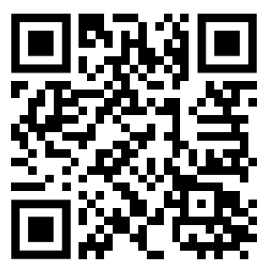
Hands-on Lab 2&3 materials
Please download the hands-on lab scripts from this github repository.
https://github.com/arnouldg/SQLDI_HoL_IDUG or
OpenVPN Credentials : 13_sqldi_educamp_20260717_userXX / sqlAdria2025
Please find the TechZone Jumpbox VMs and SQL DI username for the hands-on lab in the table below
Student | Techzone Image URL | TechZone Password | Windows User/Password | SQLDI User/Password
Student1 | hhttps://techzone.ibm.com/my/workshops/student/68776ea58a3a4d1edcbc3d62 | sqldi2025 | Administrator / IBMDem0s | zdw01 / pwd01mop
Student2 | hhttps://techzone.ibm.com/my/workshops/student/68776ea58a3a4d1edcbc3d62 | sqldi2025 | Administrator / IBMDem0s | zdw02 / pwd02mop
Student3 | hhttps://techzone.ibm.com/my/workshops/student/68776ea58a3a4d1edcbc3d62 | sqldi2025 | Administrator / IBMDem0s | zdw03 / pwd03mop
Student4 | hhttps://techzone.ibm.com/my/workshops/student/68776ea58a3a4d1edcbc3d62 | sqldi2025 | Administrator / IBMDem0s | zdw04 / pwd04mop
Student5 | hhttps://techzone.ibm.com/my/workshops/student/68776ea58a3a4d1edcbc3d62 | sqldi2025 | Administrator / IBMDem0s | zdw05 / pwd05mop
Student6 | hhttps://techzone.ibm.com/my/workshops/student/68776ea58a3a4d1edcbc3d62 | sqldi2025 | Administrator / IBMDem0s | zdw06 / pwd06mop
Student7 | hhttps://techzone.ibm.com/my/workshops/student/68776ea58a3a4d1edcbc3d62 | sqldi2025 | Administrator / IBMDem0s | Zdw07 / pwd07mop
Student8 | hhttps://techzone.ibm.com/my/workshops/student/68776ea58a3a4d1edcbc3d62 | sqldi2025 | Administrator / IBMDem0s | zdw08 / pwd08mop
Student9 | hhttps://techzone.ibm.com/my/workshops/student/68776ea58a3a4d1edcbc3d62 | sqldi2025 | Administrator / IBMDem0s | zdw09 / pwd09mop
Student10 | hhttps://techzone.ibm.com/my/workshops/student/68776ea58a3a4d1edcbc3d62 | sqldi2025 | Administrator / IBMDem0s | zdw10 / pwd10mop

Slide 7
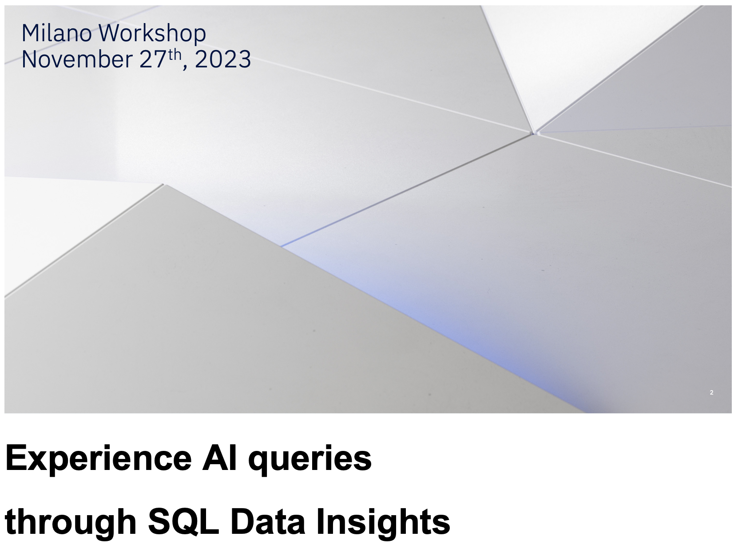
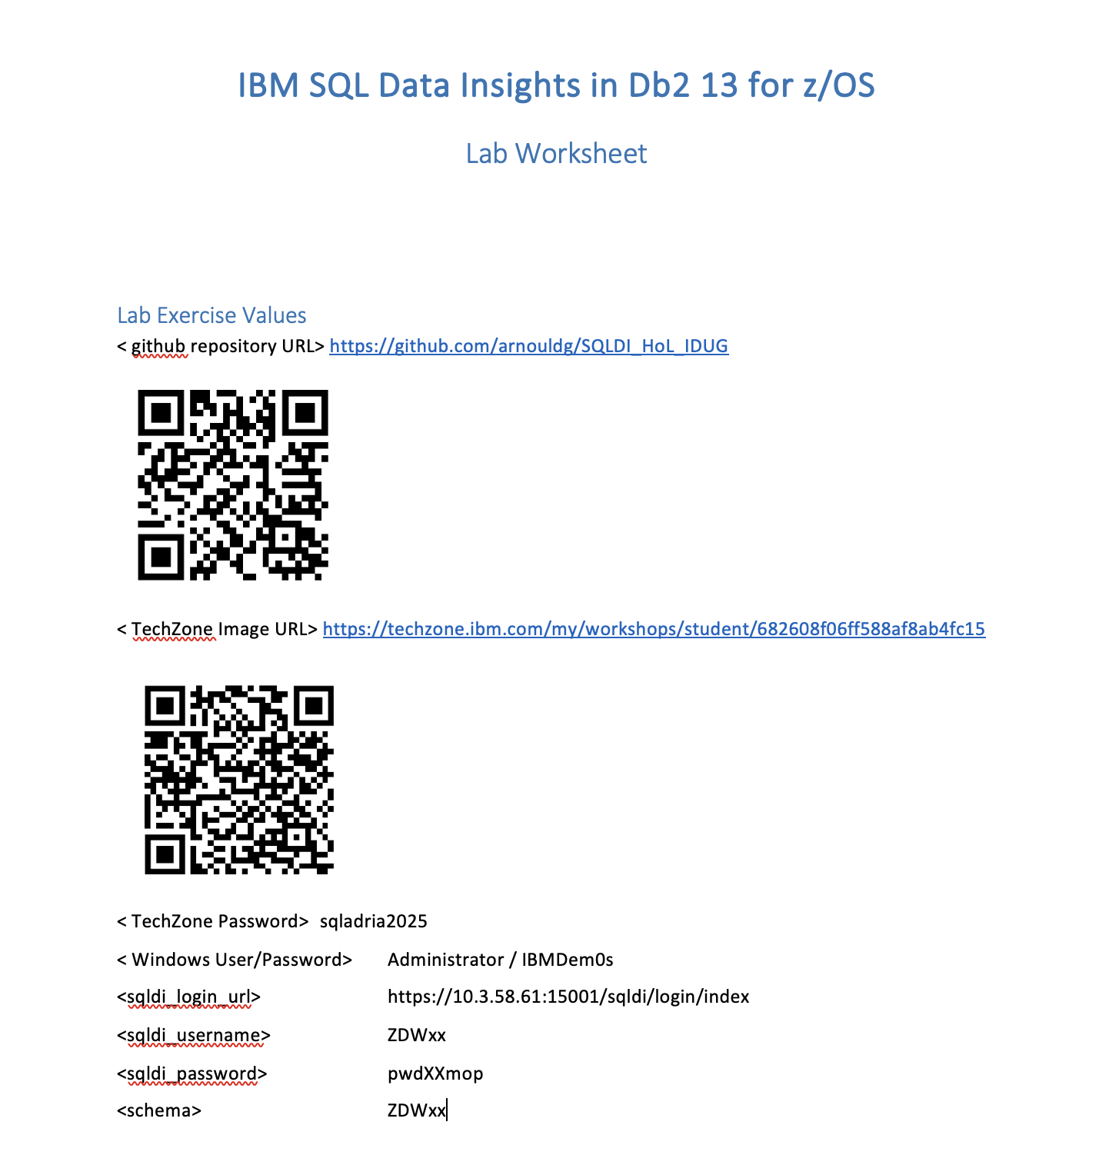


Hands-On-Lab Workbook & Credentials provided by Instructors

Slide 8
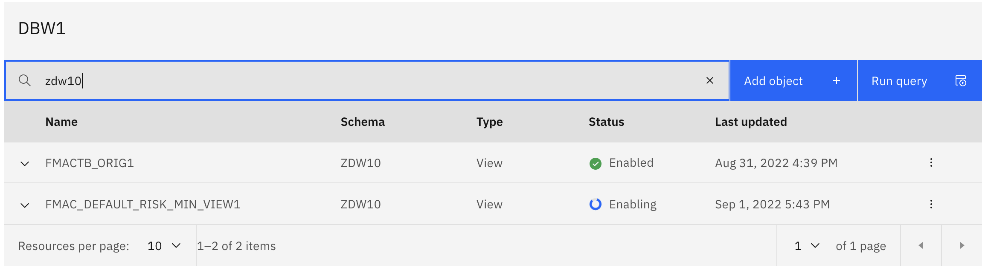
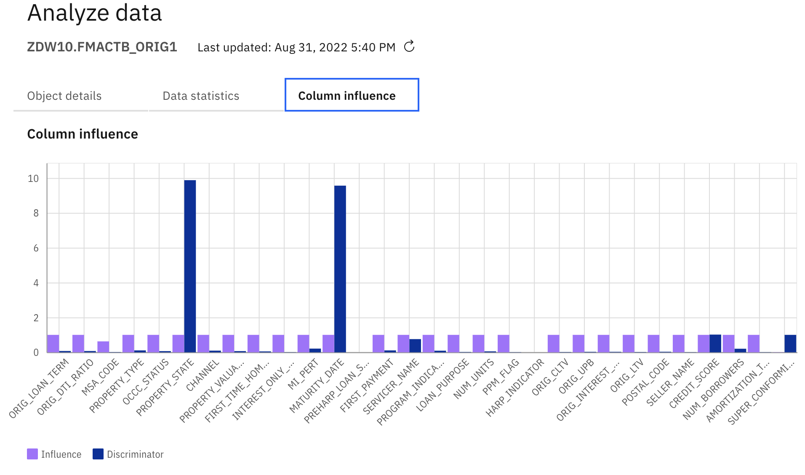
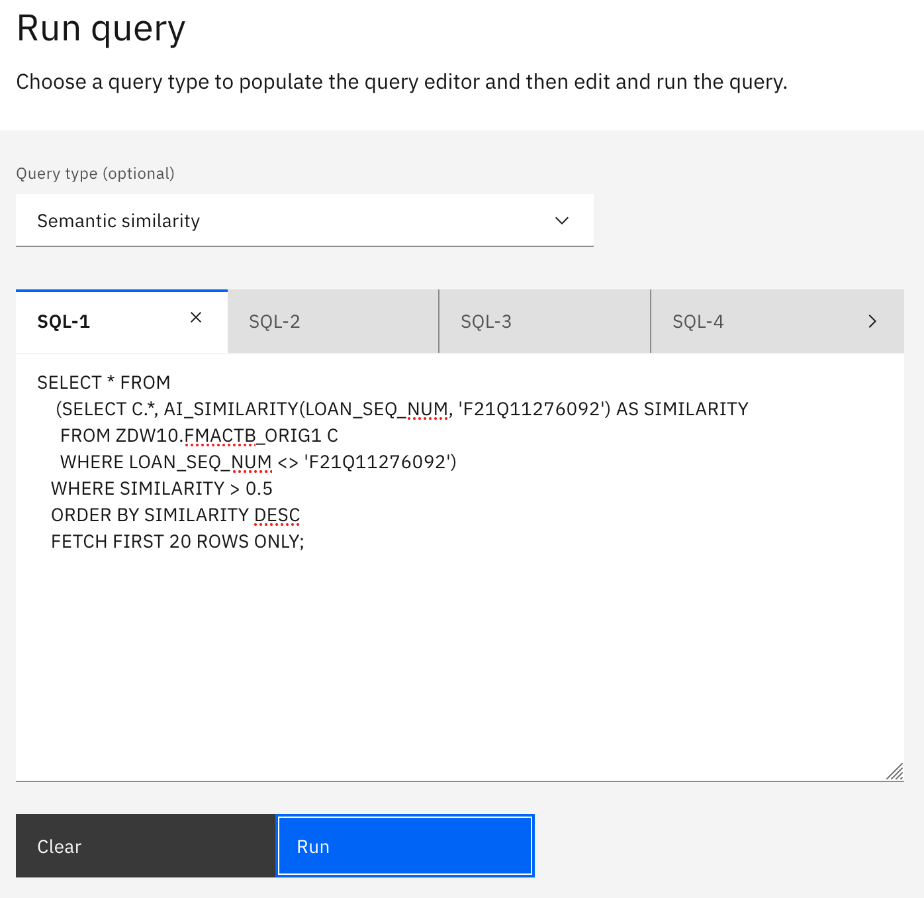
HOL Parts
1. SQL Data Insights overview
AI Semantic Built-In Functions
AI_SIMILARITY
AI_SEMANTIC_CLUSTER
AI_ANALOGY
2. LAB Exercises Preparation
3. Accessing SQL Data Insights UI
Connecting to your database
Enable AI
Monitor object training
Review training results and interpretability
5. Run Semantics queries
Uncover insights based on hidden relationships in Db2 data with AI

Slide 9
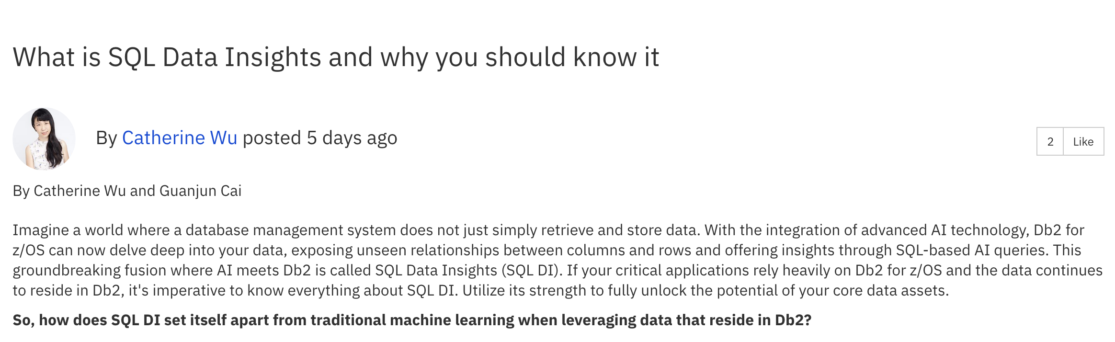
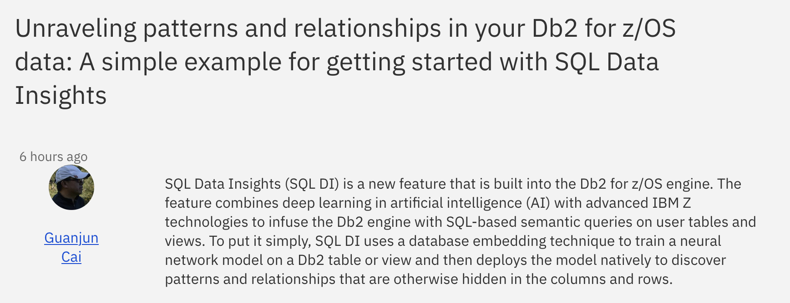
For your readings,
https://community.ibm.com/community/user/datamanagement/blogs/catherine-wu/2023/10/13/what-is-sql-data-insights-and-why-you-should-know?CommunityKey=621c2a2a-01f9-4b57-992f-36ed7432e3bb
https://community.ibm.com/community/user/datamanagement/viewdocument/unraveling-patterns-and-relationshi?CommunityKey=621c2a2a-01f9-4b57-992f-36ed7432e3bb

Slide 10

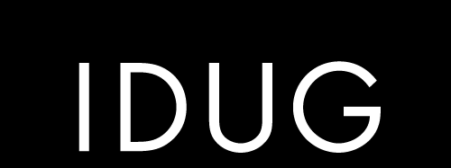
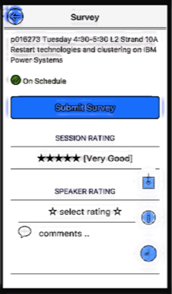
Thank you
Guillaume Arnould /
Akiko Hoshikawa /
Jae Lee
2023 EMEA Db2 Tech Conference
Please complete the session evaluation!
Session: H05

